Slide 1

Big Data & AI in business
Max Darby
DARBYM1@TCD.ie

Slide 2
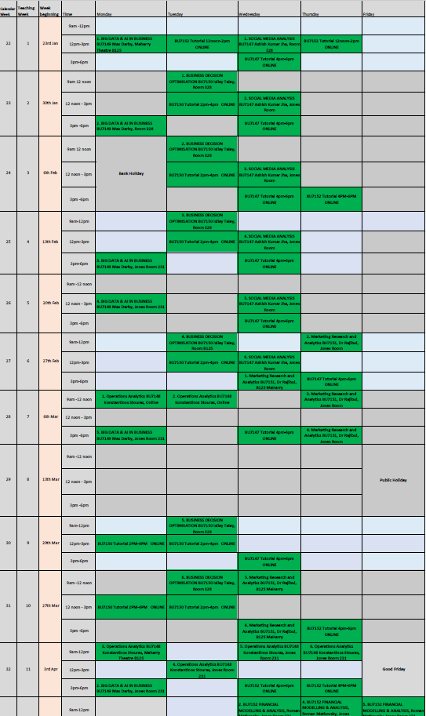
Module overview
You’ve just been appointed Head of Analytics.
What knowledge would a future Head of Data & Analytics need to lead a business using Big Data and AI?
Introduction
Big Data Architecture and Building a Data Strategy
Generating Value from Big Data
AI – under the hood
AI - applied
Emerging trends and technologies & presentations
Key learning outcome is that all of these things are design choices, and should be chosen carefully taking into account a multitude of factors. We will learn that technology is a tool to be used. It is a means to an end, and one must always know what that end is before starting.
Decide groups
Group project due
Individual assignment due

Slide 3
Attention
Check phones on average every 12 mins (this is a good example of how traditional analytical methods aren’t a good way of getting insight from big data).
The findings suggest that the mere presence of one’s smartphone reduces available cognitive capacity and impairs cognitive functioning, even though people feel they’re giving their full attention and focus to the task at hand.
Ward and his colleagues also found that it didn’t matter whether a person’s smartphone was turned on or off, or whether it was lying face up or face down on a desk. Having a smartphone within sight or within easy reach reduces a person’s ability to focus and perform tasks because part of their brain is actively working to not pick up or use the phone.
“It’s not that participants were distracted because they were getting notifications on their phones,” said Ward. “The mere presence of their smartphone was enough to reduce their cognitive capacity.”
https://www.journals.uchicago.edu/doi/full/10.1086/691462
Also, think about how you are spiking your dopamine, and how that effects your time perception and interest levels when returning to the task at hand.

Slide 4

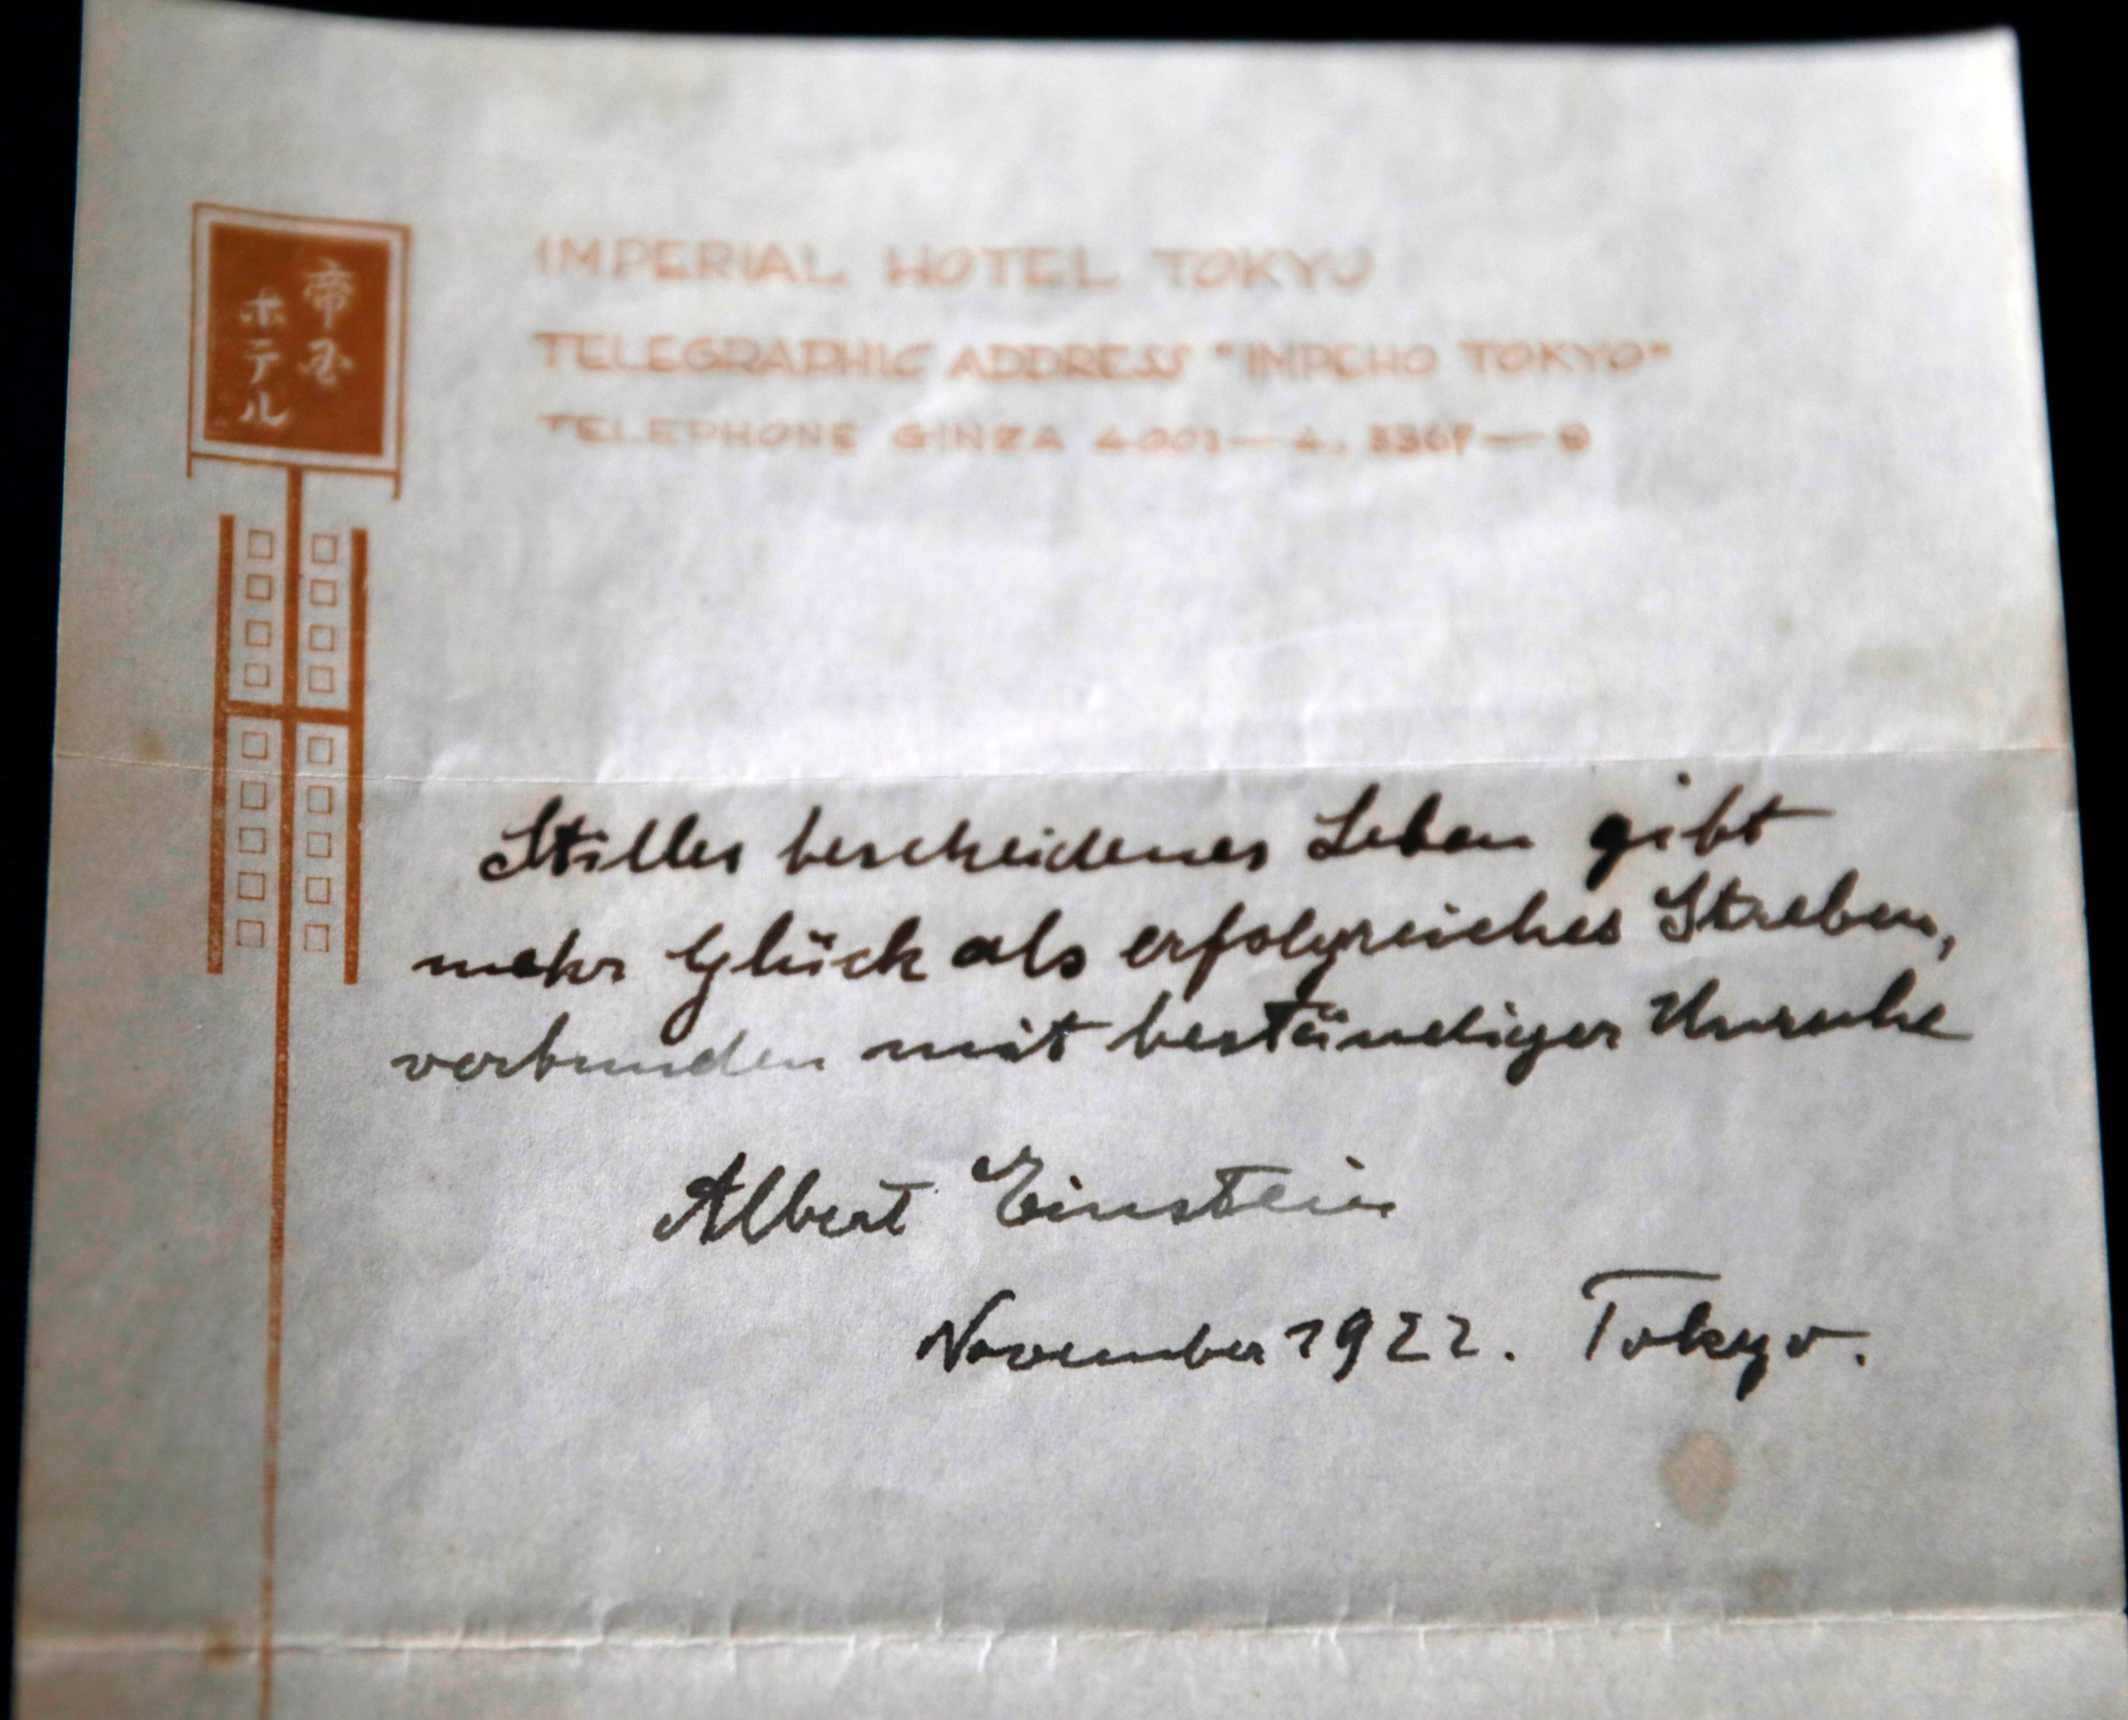
Introducing ‘data’
Plural of Latin ‘Datum’: ‘The thing that is given’
Data vs Metadata
E.g., operational data and digital exhaust
Which is more valuable?
The information itself, or what we know about the information?
"A calm and humble life will bring more happiness than the pursuit of success and the constant restlessness that comes with it."

Slide 5
$?
$1.6m
Data
"A calm and humble life will bring more happiness than the pursuit of success and the constant restlessness that comes with it."
Meta-data
Author: Albert Einstein
Date: November ’22
Location: Imperial Hotel, Toyko
Format: Memo
Quality, pen-type, ink colour, …
Einstein was on a lecture tour in Toyko in ‘22.
It was November, which means he would have just won the Nobel prize

Slide 6
History of big data
What is big data, and how did it move from data to ‘big’?
Big more refers to the way in which it is collected, stored and processed rather than a specific size threshold that it crosses
It is collected indiscriminately. Anything could be potentially valuable.
How do we treat it differently?
We collect everything first and then search for trends. The whole point of collecting it is to analyse it, not for record keeping.
How is this helpful?
We can discover things we never anticipated (Apple Pie example from Kenneth Cukier).
Previously, for example, scientific theories were developed and proven with little data. Limited to the mental vision and creativity of the scientists.
How is it unhelpful?
It is a handful – difficult to store in a way that is accessible, and even harder to analyse using traditional methods (it’s actually why the internet was built out of CERN in the 1960s)

Slide 7
Why are we only doing it now?
In essence, because of computers. Before that we were limited by human processing speeds – ‘Big Data’ is sometimes categorised by the way it is impossible for a human to process.
Three main tasks to consider:
Collecting data
Storing/Accessing data
Processing data

Slide 8
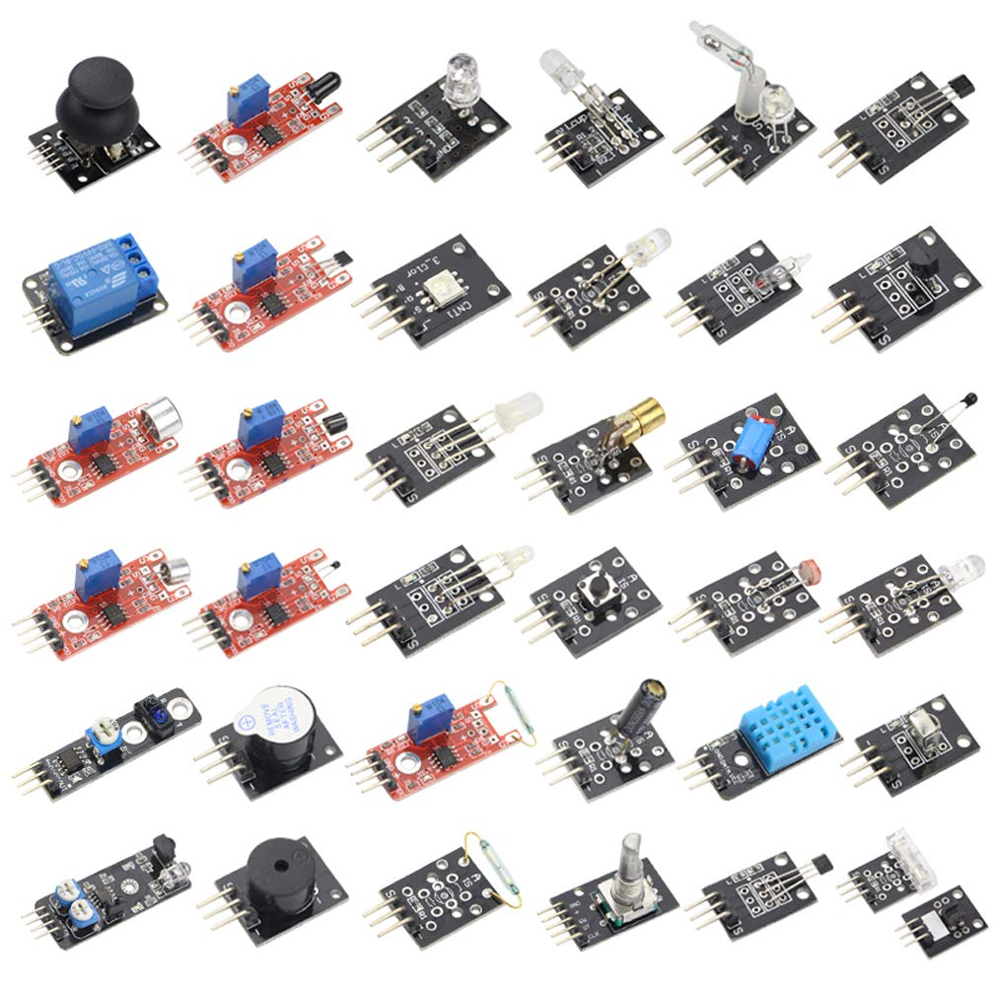
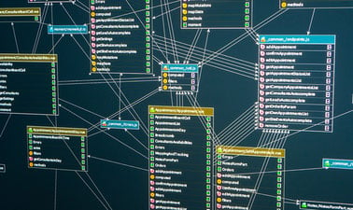
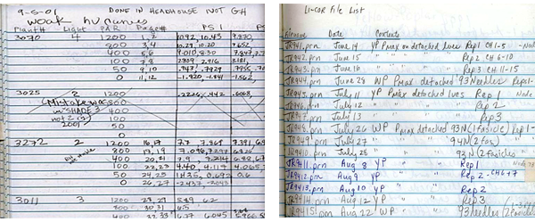
1. Collecting data
Sensors record key measures, logged in a database. Humans ensure sensors are correctly calibrated and operating as expected.
Required someone observing something and recording the number of times it happened in a log.
What was observed was very specific and pre-selected for the purpose.

Slide 9
2. Storing/Accessing data
Stored in books with mixed formatting.
No inter-compatibility (some general conventions adhered to).
Manual forms of indexing which aided search.
No automation.
Stored in a formatted database/warehouse (week 2)
Ability to query and automate

Slide 10
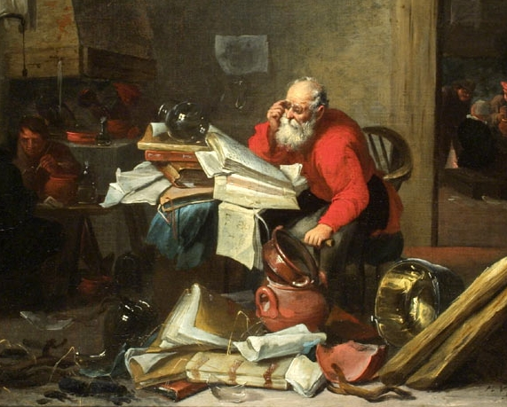
3. Processing data
Human powered.
Using data to envision potential theories and then testing them against existing/new data.
Heavy reliance on human effort, perfect conditions, creativity.
Distilling formal logic down to theorems.
No Automation
Computer powered
Writing programs to accept input and to transform in a structured and predictable way, human focus building the template and analysing the output.
More focus on interpreting results than transforming data.
Heavily automated, but also flexible and reusable. Iterative and adaptable as new data flows in
Notes:
Data has gone from a stock to a flow – i.e., from being static to something dynamic.
Think about copying data – basically have to repeat it all again, except the ‘observations’ are a bit easier.

Slide 11
Class discussion
What do you think the difference in cost would be for ‘old-school’ data collection, storage, and processing?

Slide 12
Collecting
€23.56 per day
Storing
A dry room: €883 per month
€0.15 per GB per month (1,700 books).
Processing
A LOT
2 days data science consultancy: €1300
~€20 up front cost for sensors.
€0.01-€0.02 per day running costs.
VS
VS
VS

Slide 13
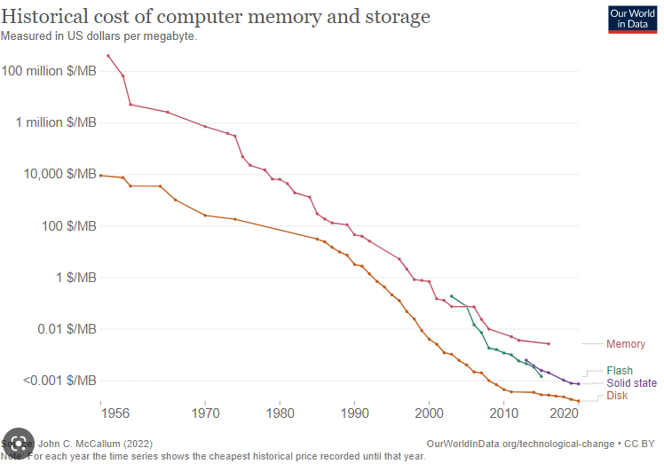
Even in Recent years – data costs are becoming tiny…
So far we’ve been comparing computer vs pre-computer, but even in recent years the cost of data has become infinitesimal.
(And we’ll see in later lectures where money will be made, now that collection, storage and processing is effectively free – hint: it’s AI subscription models, like a neo-corporate-feudalism).

Slide 14
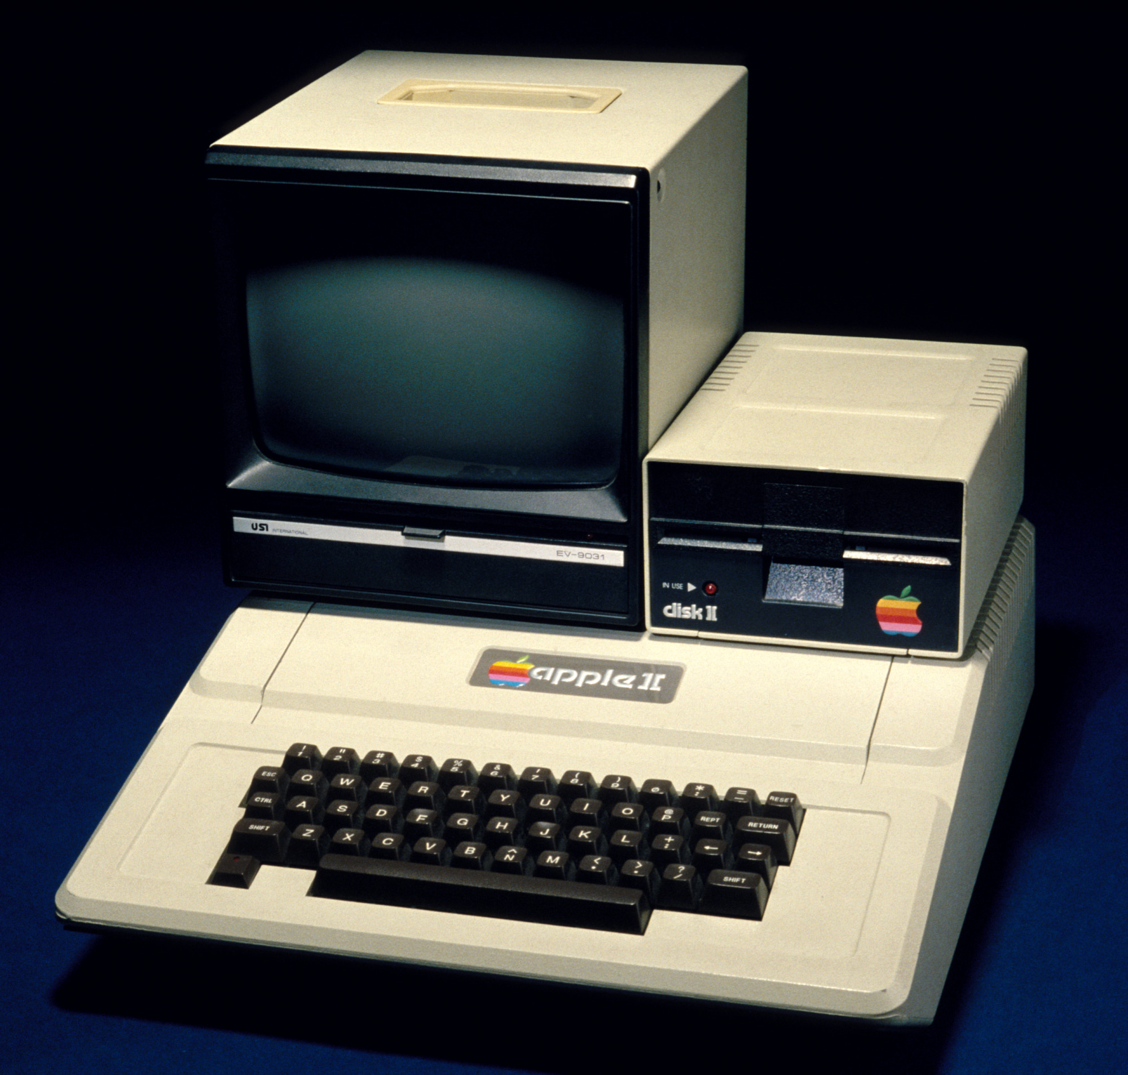

For example, Difference in apple products
1980 – Apple II - $4,800
2023 – Apple MBP M2 - $4,000
16 MHz
1MB of RAM
40MB hard-drive
3.49GHz (3490 MHz ~400GB/s)
96GB (96,000MB) of RAM
8TB (8,000,000MB) SSD

Slide 15


Class discussion
Without using a search engine or a calculator, try to come up with two things that can be measured that you estimate are roughly a factor of a million apart.
E.g., the speed of a snail vs. the speed of the International Space Station

Slide 16
This changes the way write programs
Formal logic + limited data and Expensive processing
Machine learning + big data & cheap processing
“The machines were initially conceived as general-purpose calculators for tasks like building ballistics tables for the military during WWII” Kaplan, p.21
Focus on distilling difficult tasks into strings of logical axioms (‘heuristics’)
Do this, then that..
‘Knowledge engineers’ creating ‘expert systems’.
Focused on programming architecture that can learn.
Computer programme does the distilling/refining to find heuristics. Back-prop, gradient descent, neural nets, etc.
We will come back in more depth later in the course…

Slide 17


Big data summary
The amount of data we collect, store and process now is close to unfathomably large.
It means we need to think about it differently. Rather than as a stock of data we need to think about it as a ‘flow’.
This changes how we interact with it – moving to a more experimental, recursive, and incremental framework and away from a linear one. Both in programming but also how we structure our business functions that are becoming data-driven. We need to build models, not laws.

Slide 18
So now we understand what big data is and how it is changing the way we create programs
As we discussed, there isn’t much of a case for collecting Big Data if you don’t plan on analysing it. It does still cost something, and that bill can get quite large when you move into petabytes & gigahertz…
This is where we need to start thinking about Data Strategy.

Slide 19
Data Strategy
“A data strategy is a long-term plan that defines the technology, processes, people, and rules required to manage an organization's information assets” – Amazon
“A data strategy is a highly dynamic process employed to support the acquisition, organization, analysis, and delivery of data in support of business objectives.” – Gartner
“set of choices and decisions that together, chart a high-level course of action to achieve high-level goals” - DAMA

Slide 20
What is a Data strategy?
#1 priority in every org – data is where businesses are going to find their next growth.
Knowing how to make a data strategy will help you plan how to use your data – something businesses know they need to do, and they know that it is where value can be generated, but they don’t know where to focus their efforts – it’s a whole new area where the handbook hasn’t been completely written yet.
E.g., Where to focus? Data monetisation (selling assets), building a new product (entering a new market), process improvement (reducing costs), personalisation (taking market share), etc?
As with any strategy, it is imperative that whoever makes the data strategy understands the business intimately – and is aligned with their commercial goals and long-term plans.

Slide 21
Why is a data strategy important?
ALL of this is designed. Nothing here is a given. It is in these data strategies where the future of AI (& society) will be shaped.
E.g., on the use of ‘digital exhaust’. That was a design choice on how to monetise behaviour on the internet. It wasn’t an obvious next step in web development, it was a data strategy which addressed the business case of generating profits from internal assets.

Slide 22
Class discussion
What can you think of that is common-place in life right now that we don’t usually consider as having been designed, and could have been designed completely differently and reached the same end? (or even perhaps a better one!)

Slide 23

How about privacy? – invented by us and now at risk of being lost
Don’t Hex The Water – exurb1a

Slide 24
What should be addressed?
Identification & Collection
Storage
Provision/Access (Usability)
Integration (remember, we used to just care about data in isolated processes, now we want it all together, + metadata).
Governance (data accuracy, data dictionaries, data owners, etc).
People: Who does what? How many of each? What is the scope of their role?
https://www.sas.com/content/dam/SAS/en_au/doc/whitepaper1/five-essential-components-data-strategy.pdf

Slide 25
High-level Design
Think about different lenses, and various business needs.
Defensive (legal, financial, compliance, IT): designed around minimizing risk. E.g., ensuring compliance, privacy, integrity, fraud analysis, standardisation and governing.
Offensive (customer-facing/competitive markets): ‘supporting business objectives’, increasing revenue, profitability, customer experience. Insight analytics, process modelling, market intelligence.
Most strategies will need to address both, with different weightings
E.g., Hospitals are highly regulated and need a lot of protection, contrasted with Social Media or Retail which is highly-competitive and reactive. Then you have examples like banking, which is in the middle: highly regulated but also operate in dynamic markets.
Balance control and flexibility
Notes:
“Decisions about these trade-offs are rooted in the fundamental dichotomy between standardizing data and keeping it more flexible. The more uniform data is, the easier it becomes to execute defensive processes, such as complying with regulatory requirements and implementing data-access controls. The more flexible data is—that is, the more readily it can be transformed or interpreted to meet specific business needs—the more useful it is in offense. Balancing offense and defense, then, requires balancing data control and flexibility, as we will describe.” - https://hbr.org/2017/05/whats-your-data-strategy

Slide 26
Who should build it?
“The problem is that data investments must deliver near-term value and at the same time lay the groundwork for rapidly developing future uses, while data technologies evolve in unpredictable ways, new types of data emerge, and the volume of data keeps rising”
IT architect
business imperative
Domain-knowledge expert
analytics/information/data science expert
Futurist visionary

Slide 27
Data strategy & a change in mindset
Becoming ‘data-driven’.
Companies using big data, and also generating big data. It all feeds back in..
Remember we spoke about the need to move from a linear mindset to a recursive/experimental/incremental one.
We’re all scientists now. Yes, even the marketing team.
How are you going to bring people on this journey? How will you upskill them and teach them to unlearn and re-learn?

Slide 28
Why are we thinking about Data strategy?
We’re going to use the idea of a data strategy to understand how we would decide what data we would collect, and could we justify it being ‘big’, and the different tools we could use to do it, given different demands. And then what tools we’d use to generate value from that data (because we’re not doing all this just for AI, we also want to use this big investment to generate value elsewhere!).
For the most part it’s a trade-off between cost and accessibility (blob storage up to in-mem/RAM graph db).
We’ll explore how to collect and store big data, and what you should factor in when making that decision. And most of all we’ll think about how we’ll shape it based on business-needs and future development (AI, 5G)
Obviously all this is leading to a discussion about AI…

Slide 29
Data strategy & AI
And so we will be using our Data Strategy as a way of framing our discussion about AI.
We need to think about technology (in this case AI) as a tool for achieving a goal (the strategy). Not technology for technology sake.
We need to think carefully about how we will structure our entire data environment, because it is this environment that will be making very real decisions on behalf of people. We need to ensure we build it with technological mastery and foresight.
You will learn to build better systems, make more rounded decisions, become conscious of cost and return (long and short-term), pursue genuine business goals (not the next shiny thing), and ultimately run more successful teams that are aligned to generating value (for their company and society).
The alternative is we just run through loads of shiny new exciting pieces of tech but no real understanding of when to use them. Which I’ve seen a lot of start-ups (& large data science teams!) make the mistake of doing: JLR hiring loads, AH with 80+ data scientists, DC building huge graph DBs, etc. Loads of highly talented people chasing technological development without any strategy.

Slide 30
What’s next?
Remember at the beginning of this lecture you were announced as the new Head of Analytics? Already forgotten you have that job?
Well, you’ve brought your Exec team through how (meta)data has changed and why they need Big Data. You’ve explained to them how it’s a new paradigm and there’s “gold in them thar hills”. They’re sold on the concept, and asking you for a plan on a page and an estimated budget.
Crap. You didn’t think this far ahead. In fairness, you’ve only been in the role for 2.5 hours…
Week 2: Big Data architecture and Data Strategy
Week 3: Analysing Big Data and the new Programming Paradigm

